Slide 1
Move database api - http://docs.themoviedb.apiary.io/#reference/changes/moviechanges
Api_key: 9bcc7d5492fb90c523ac4607906011eb
Change Language:
http://stackoverflow.com/questions/12908289/how-to-change-language-of-app-when-user-selects-language

Slide 2
Login
Connecting to the Network
The Movie Fan
http://developer.android.com/training/basics/network-ops/connecting.html
Email
Password
Log in
Sign up

Slide 3
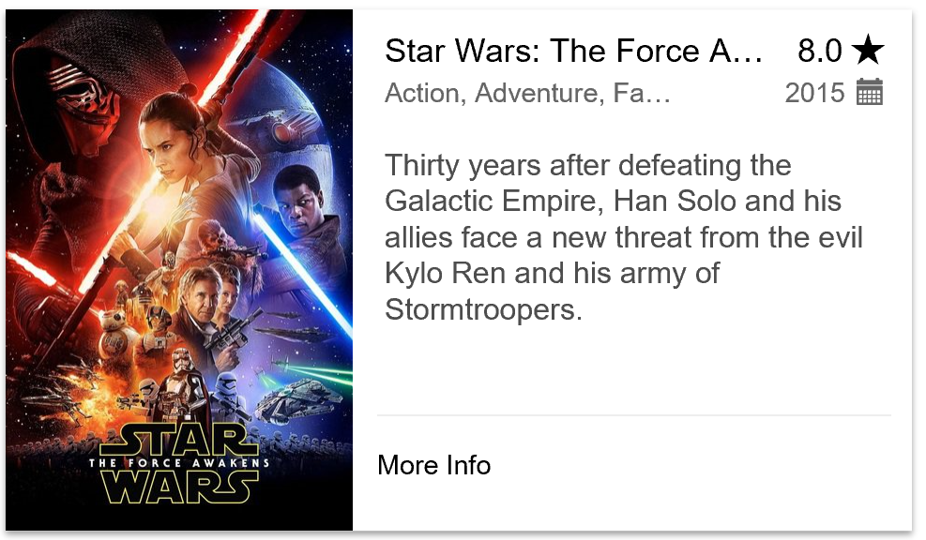
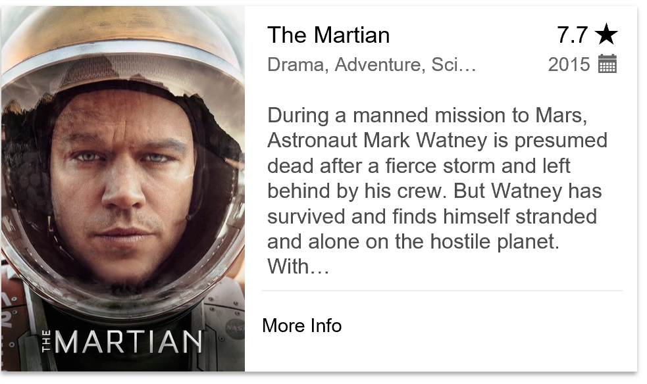
Home Page
Popular Movies
Gets popular movies from Movie database:
- filter by rank and date
http://api.themoviedb.org/3/movie/popular?api_key=9bcc7d5492fb90c523ac4607906011eb
Add Search button

Slide 4

Add to favorites
Details about a movie that the fan has seen. Including:
Fan rank
Fan notes about the movie
Fan pictures about the movie (taken with the camera at the premiere for instance)
Movie Title
Save
Overview
During a manned mission to Mars, Astronaut Mark Watney is presumed dead after a fierce storm and left behind by his crew. But Watney has survived and finds himself stranded and alone on the hostile…
My Rank:
8
+

Slide 5


Add to favorites
Details about a movie that the fan has seen. Including:
Fan rank
Fan notes about the movie
Fan pictures about the movie (taken with the camera at the premiere for instance)
Add to favorites
Save
The Martian
Overview
During a manned mission to Mars, Astronaut Mark Watney is presumed dead after a fierce storm and left behind by his crew. But Watney has survived and finds himself stranded and alone on the hostile…
My Rank:
8
Notes
Great movie, want to see it again.
Fan Photos
Add

Slide 6

Add photo
Details about a movie that the fan has seen. Including:
Fan rank
Fan notes about the movie
Fan pictures about the movie (taken with the camera at the premiere for instance)
Add Photo
Save
Notes

Slide 7
Movies to see
Movies to see

